Slide 1
Section 1.4 square Roots and Mixed Fractions
© Copyright all rights reserved to Homework depot: www.BCMath.ca

Slide 2
I) Mixed Radicals
When converting Entire radicals to Mixed Radicals, use perfect squares:
Entire Radicals
Perfect Squares
Mixed Radicals
Use the largest perfect square possible when simplifying

Slide 3
Ex: Convert to Mixed Radicals
Find 2 numbers that multiply to 350 and involves a perfect square
Square root the perfect square to eliminate the radical sign
Multiply

Slide 4
Simplifying Cubic Roots
When simplifying cubic roots to Mixed Radicals, use perfect cubes:
Find 2 numbers that multiply to 81 and involves a perfect cube
Cube root the perfect cube to eliminate the radical sign
Multiply

Slide 5
Ex: Convert to Mixed Radicals:

Slide 6
i) What is the lowest value of “a+b” given the equation below?

Slide 7
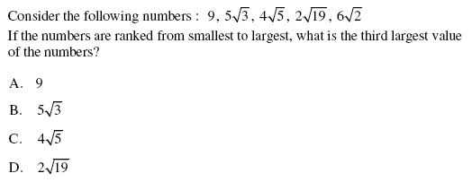

Slide 8
If each of the smaller squares are congruent, then what is the area of each of the smaller squares?
18cm²
?
12cm²
?
?
27cm²
50cm²
?
48cm²
Answer
Answer

Slide 9
Challenge: three cubes with volumes that are integral values are stacked up on another. IF the height of the three cubes are in the form of and then how many ways can these cubes be created so that the cubes must be stacked in descending order?

Slide 10
Homework:

